Slide 1
Senior Project Final Presentation <Summer 2016>
BOLO 5.0 Team Members: Emmanuel Gonzalez, Nilton Muñoz, John Burke, Jorge Medina
Instructors: Masoud Sadjadi, Mohsen Taheri Product Owner(s): Samuel Ceballos, Jason Cohen
Mentors: Juan Caraballo, Robert Loredo School of Computing and Information Sciences Florida International University
August 5th, 2016
Notes:
Greet your audience, thank them for attending your presentation, introduce yourself, introduce your project, introduce your team members, and quickly indicate what each of you did in a high-level manner, and put more emphasis on your part/contribution.

Slide 2
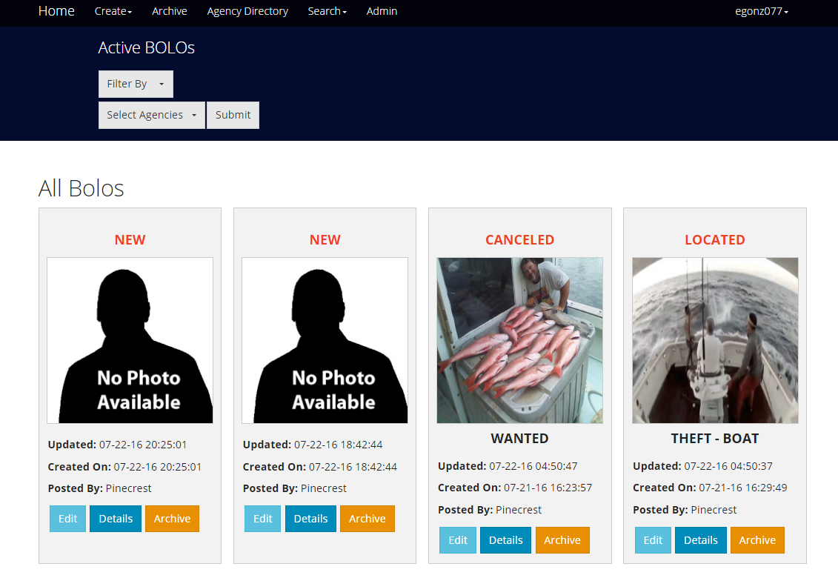
Project Definition
The BOLO flier creator is a web application that allows law enforcement to catch criminals faster.
Notes:
Introduce the problem that the whole project tackles and stay focused on the parts that you have been working. Indicate if there is an existing previous system, enumerate its problems/limitations, etc.

Slide 3
Project Definition
Bolo 5.0: Has added the following functionality to the project
Security Enhancements:
Brute Force Login Protection
HTTPS Enforcing
90 Day Password Expiration Policy
BOLO confirmations
System Roles rules
Update DB Schema keeping data
User Management (activate - deactivate users)
User Registration
Output of Data:
JSON feed to third party Agencies
CSV output for statistical analysis
Previews, Details and PDF Views for templates
Retrieval Points for Data analysis
Visual Enhancements:
Redesigned navigations
Watermarks for BOLO PDfs
New Filtering for viewing BOLOs.
Custom Templates
Templates for BOLO Boat Theft and Auto Theft
New search pages for the new templates
Notes:
Introduce the problem that the whole project tackles and stay focused on the parts that you have been working. Indicate if there is an existing previous system, enumerate its problems/limitations, etc.

Slide 4
Use Cases

Slide 5
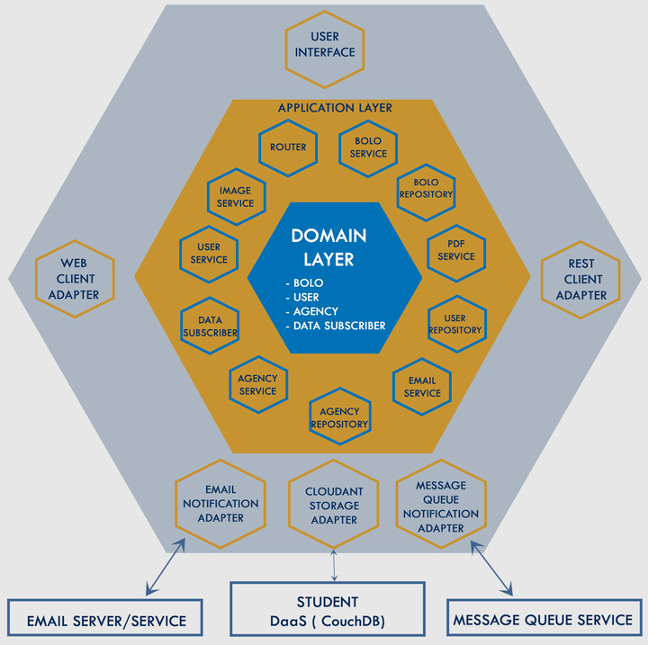
Architecture

Slide 6
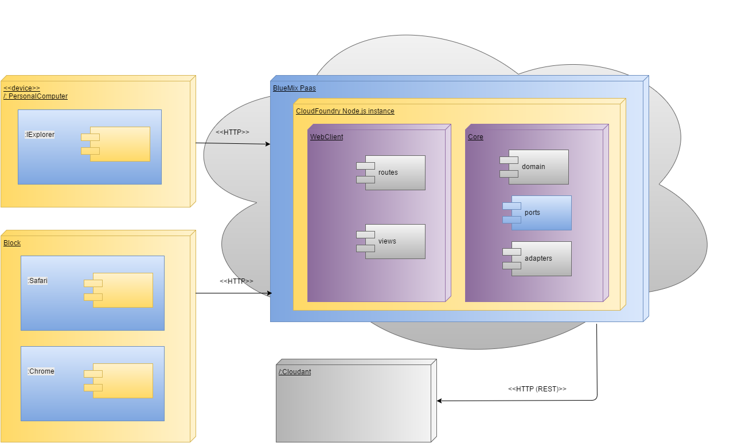
Architecture

Slide 7
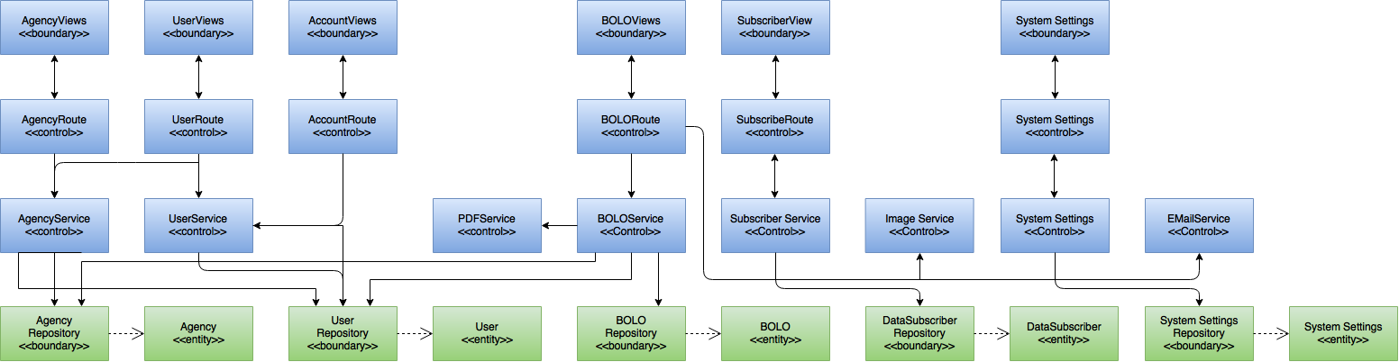
Minimal Class Diagram

Slide 8
Use Cases
Users must confirm BOLO’s after creation.
Users can be locked out of the system if they input wrong login information 10 times.
User’s login credentials will expire every 90 days.
Upon registration user email must be associated to their agency’s domain.
Filter BOLOs by any permutation of agencies.
Notes:
4. Requirements:
4.1. User stories implemented (one or more slides).
4.2. UML use cases and the use case diagram for the implemented use cases (one or more slides).
4.3. UML sequence diagrams for the implemented use cases.

Slide 9
Confirm BOLOs after creation

Slide 10
Confirm BOLOs after creation

Slide 11
Brute force attack protection

Slide 12
Password expiration policy

Slide 13
Restrict User email domain on registration

Slide 14
Filter BOLOs by any permutation of agencies
Implement new dropdowns using Bootstrap.
Modify database query to accept an array of keys as a parameter.
Allow the user to select any permutation of agencies.
Fix paging algorithm to accommodate different amounts of BOLOs.
Display BOLOs by the agencies selected.
Notes:
4. Requirements:
4.1. User stories implemented (one or more slides).
4.2. UML use cases and the use case diagram for the implemented use cases (one or more slides).
4.3. UML sequence diagrams for the implemented use cases.

Slide 15
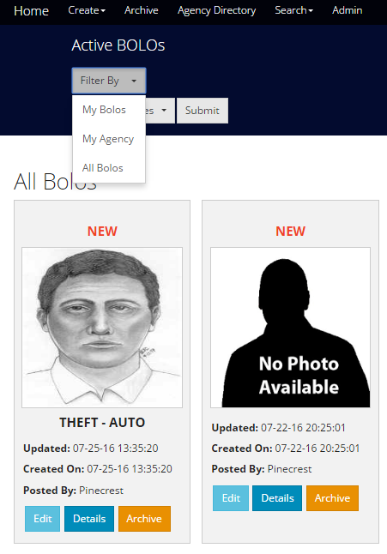
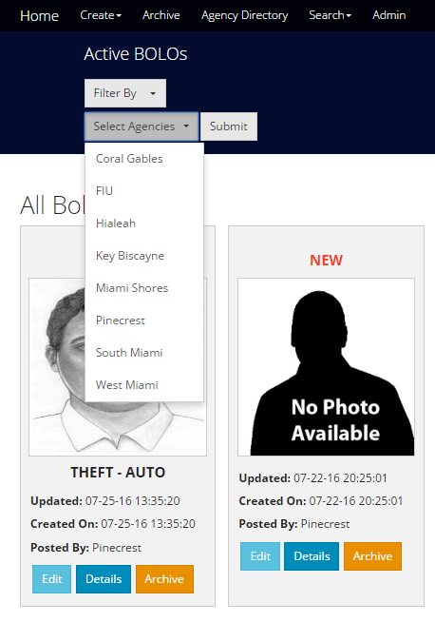
Implement new drop-down menus

Slide 16
Multiple Selections

Slide 17







Summary
Contact:
Email: egonz077@fiu.edu
Phone: 786-419-1966
Linkedin: www.linkedin.com/in/emmgonz
Any Questions?
Notes:
Summarize your contribution
Include your contact information
Ask if anyone has any questions for you.
Thank your audience

